Slide 1
BASIC SKILLS IN VOLLEYBALL

Slide 2
OBJECTIVES
At the end of the lesson, student should be able to:
Learn the different skills in Volleyball
Perform the different skills
Apply the different skills in an actual game

Slide 3
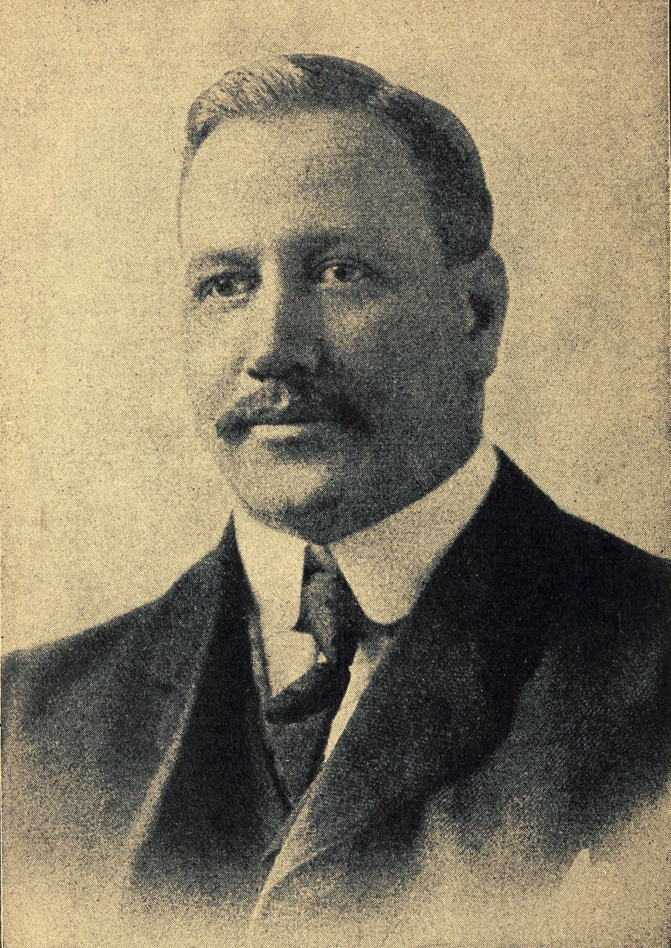
History of Volleyball
Created in the United States in 1885
William G. Morgan of the Young Men’s Christian Academy is credited with its creation
Decided to blend elements of basketball, baseball, tennis, and handball
He intended to create a game for his classes of business when which would demand less physical contact than basketball
Originally the game was called mintonette.
During a demonstration game, someone remarked to Morgan that the players seemed to be volleying the ball back and forth over the net, and perhaps "volleyball" would be a more descriptive name for the sport.

Slide 4
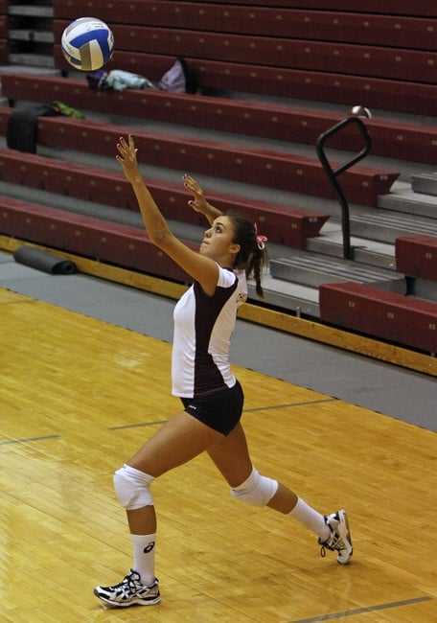
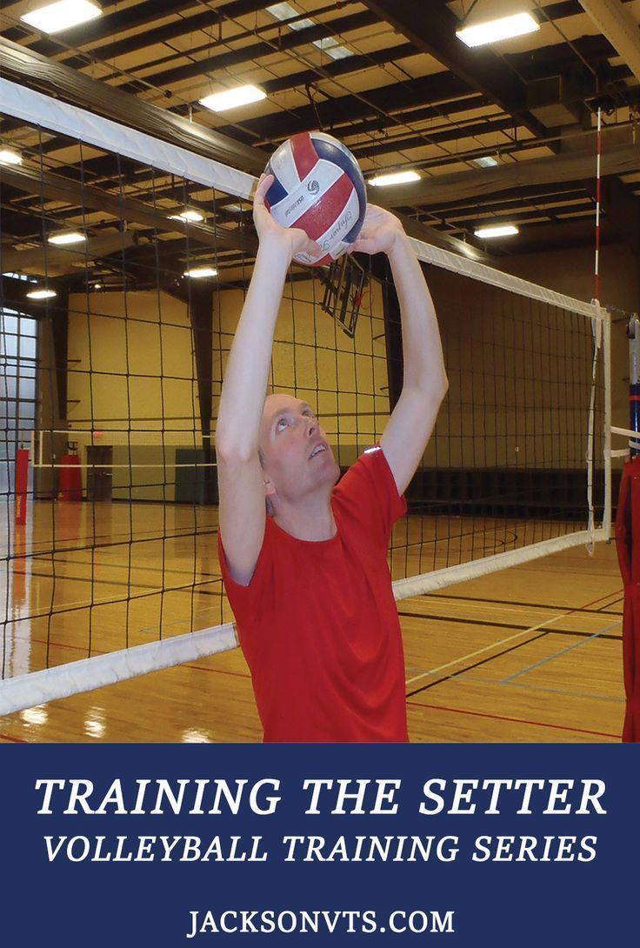
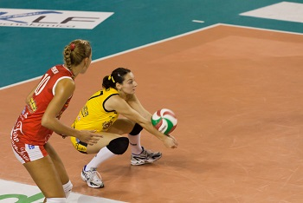
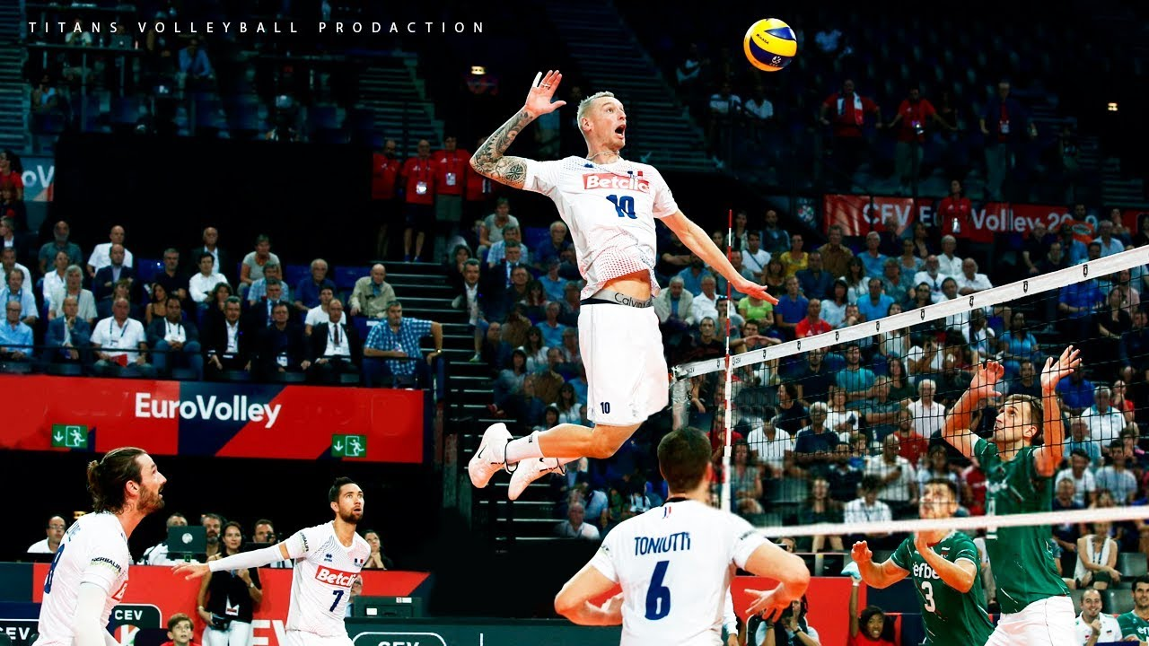
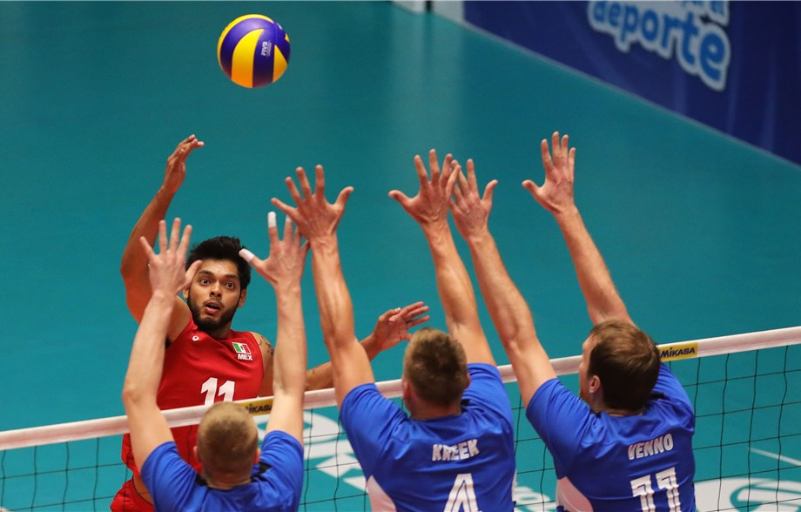
Five Basic Skills in Volleyball

Slide 5
Serve Station
Use wall space. Tape a target height and distance for students to practice serve.
VIDEO

Slide 6
Block Station
Use the left side of net, both courts. Students will work in partner pairs on either side of the net. They will jump with arms raised, clap hands over the net, then repeat.
VIDEO

Slide 7
Forearm Pass Station
Any open space. Students will work in partner pairs to toss the ball and return with the forearm pass, taking turns.
VIDEO

Slide 8
Overhand Pass Station
Any open space. Students will work in partner pairs to toss the ball and return with the overhand pass, taking turns.
VIDEO

Slide 9
Spike Station
Right side of net, both courts. Students will work with a partner who tosses the ball so they can practice the spike. Take turns.
VIDEO

Slide 10
ACTUAL GAME
Students will apply the basic skills in an actual game and they will be guided and graded according to the rubrics.
For students to perform the skills perfectly, they can go back to the slides provided below.
Serve Station
Block Station
Forearm Pass Station
Overhand Pass Station
Spike Station

Slide 11
RUBRICS
 | Basic Volleyball Skills
Score (1-4) | Skill Performed | Novice (1) | Learner (2) | Average (3) | Perfect (4)
 | Forearm Pass | Hands apart while passing, little weight shift, no control over ball and its path. 1-2 to target. | Elbows and knees locked, weight on heels of feet, hands in incorrect form, ball not to target. 3-5 to target. | Knees bent, athletic stance, hands properly together, arms extended, control of ball. 5-7 to target. | Knees bent, athletic stance, hands properly together, arms extended, on balls of feet control of ball, pass to target. 8-10 to target.
 | Setting | Feet not shoulder width apart, ball not controlled, considered a lift. 1-2 to target. | Sets ball above head, bends knees, feet shoulder width apart, hands in triangle form, ball goes to target. 3-5 to target. | Sets ball above head, knees, and elbows bent and fully extended when contacted with ball, shoulders face target, ball goes to target. 5-7 to target. | Sets ball above head, knees, and elbows bent and fully extended when contacted with ball, uses finger pads to contact ball, shoulders face target, ball to target. 8-10 to target.
 | Hitting | Incorrect approach overall, 1 to 2 successful hits out of 10 over and in the court. | Okay approach, incorrect footwork, elbow below head- 3 to 5 successful hits out of 10 over and in the court. | Correct approach, left right left footwork, elbow above head, follow through - 5 to 7 successful hits out of 10 over and in the court. | Correct approach, left right left footwork, elbow above head, follow through 8 to 10 successful hits out of 10 over and in the court.
 | Serving | Ball not over or near net, ball hit off fingers or wrist. 1-2 to target. | Serve made over net, not correct weight transfer. 3-5 to target. | Serve over and in, serve included weight transfer and correct contact. 5-7 to target. | Serve over and in, serve included weight transfer and correct contact, ball intricate to pass. 8-10 to target.
 | Communication | No communication runs into teammates. | Listens to teammates but does not call for balls. | Calls for most balls, listens for teammates, encourages interaction. | Calls for all balls, listens to teammates when they call balls, talks throughout entire play.
 | Teamwork | Rude to teammates, puts others down. | Puts self-down when making mistakes (shuts down) | Cheers on teammates while staying optimistic. | Includes everyone in game, support teammates.
 | Sportsmanship | Not honest, argues with teammates and opponents. | Dishonest, puts teammates and opponents down, pessimistic towards game. | Honest play helps teammates with skills and play, polite towards opponents. | Follows all rules, takes charge with bettering team and opponents’ skill and knowledge wise with a good attitude.

